Slide 1
Mini project ideas
ANAND PAUL

Slide 2
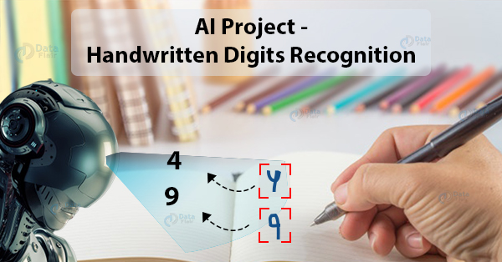
Handwritten Digits Recognition

Slide 3
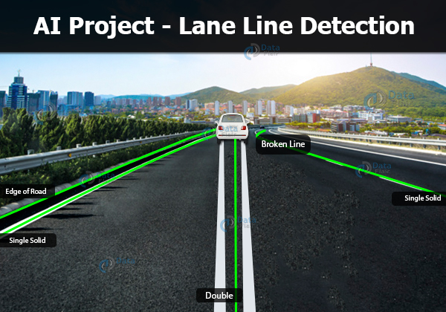
Lane Line Detection

Slide 4

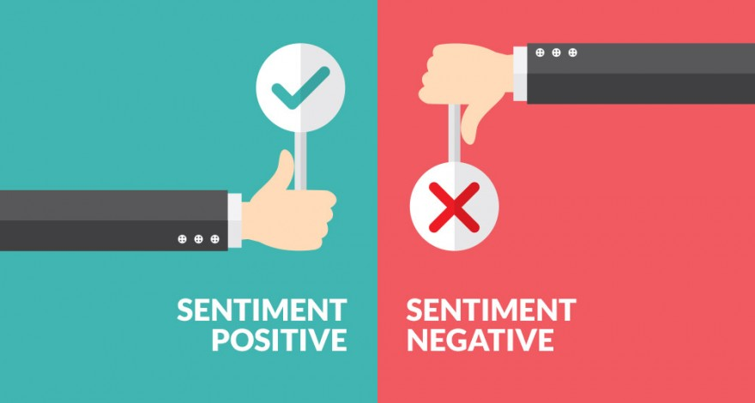

Sentiment Analysis

Slide 5
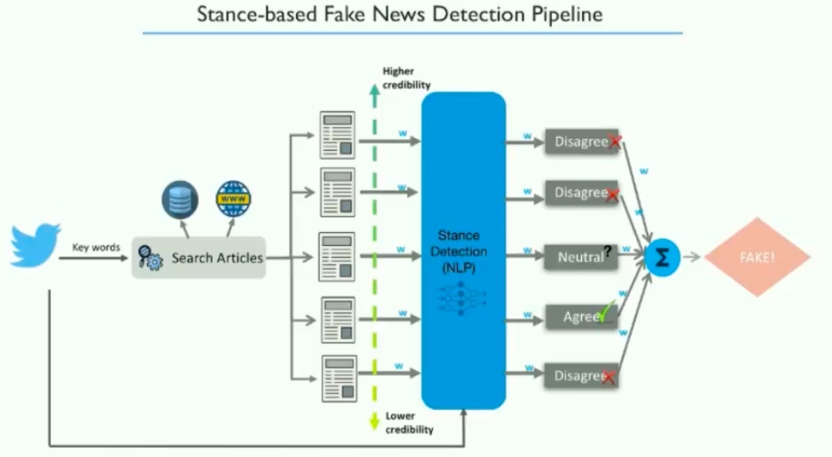
Fake news detection

Slide 6
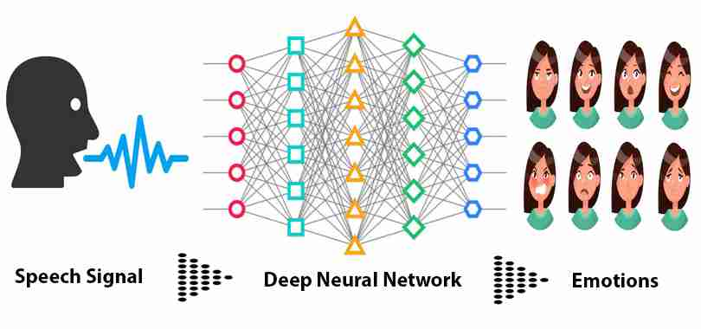
Speech based emotion recognition

Slide 7
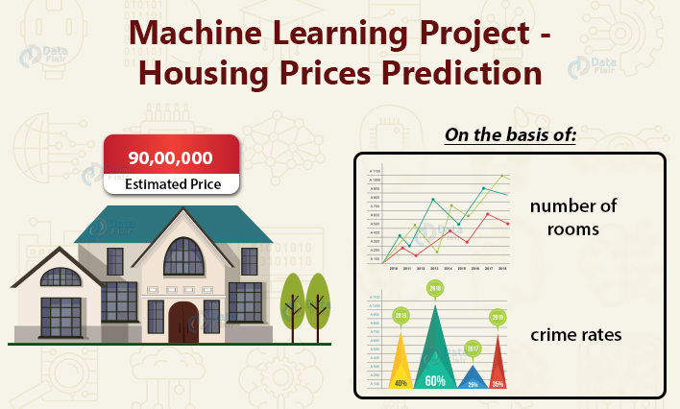
House price prediction

Slide 8

Stock price prediction

Slide 9
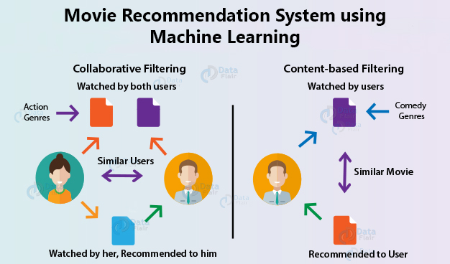
Recommendation system

Slide 10
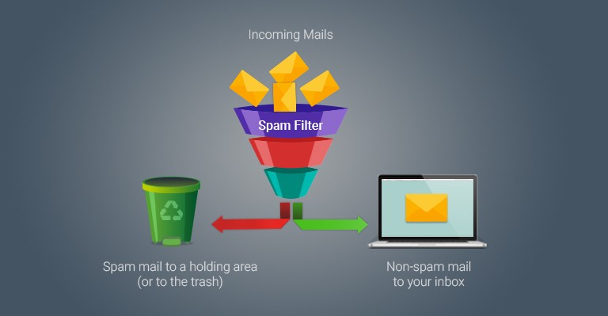
Spam and non-spam

Slide 11
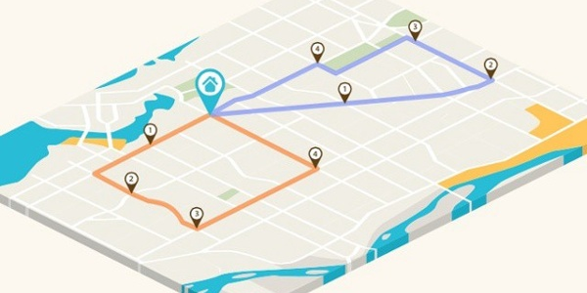
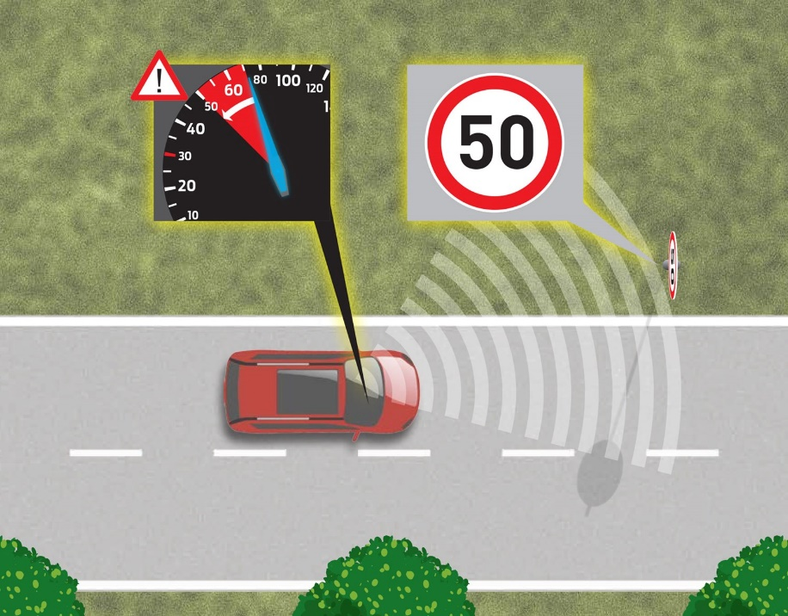
Route optimization Traffic sign

Slide 12
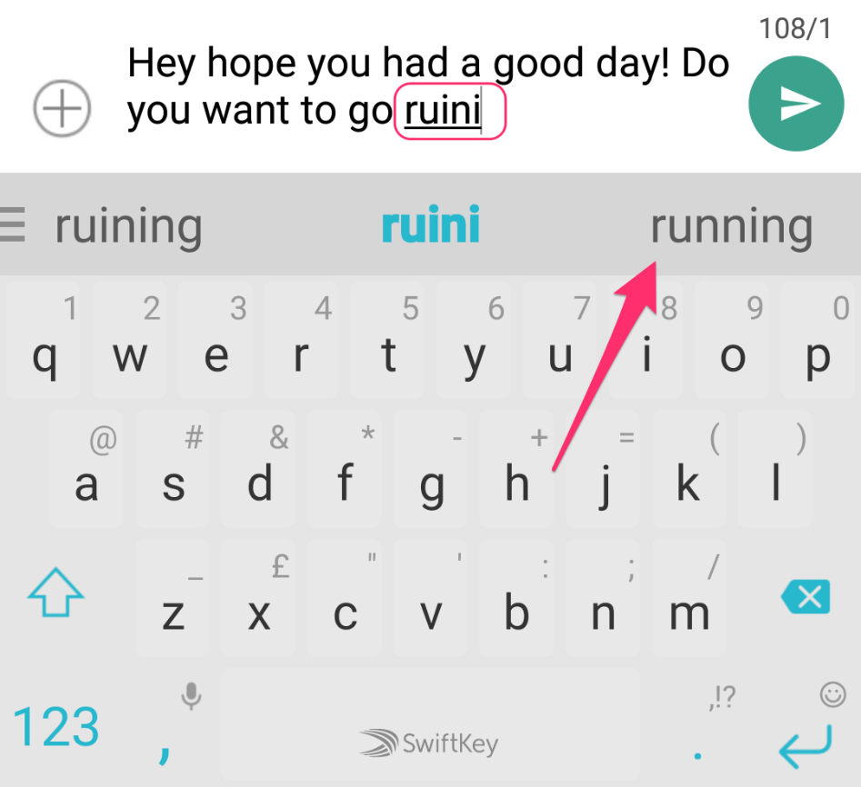
Next word prediction

Slide 13
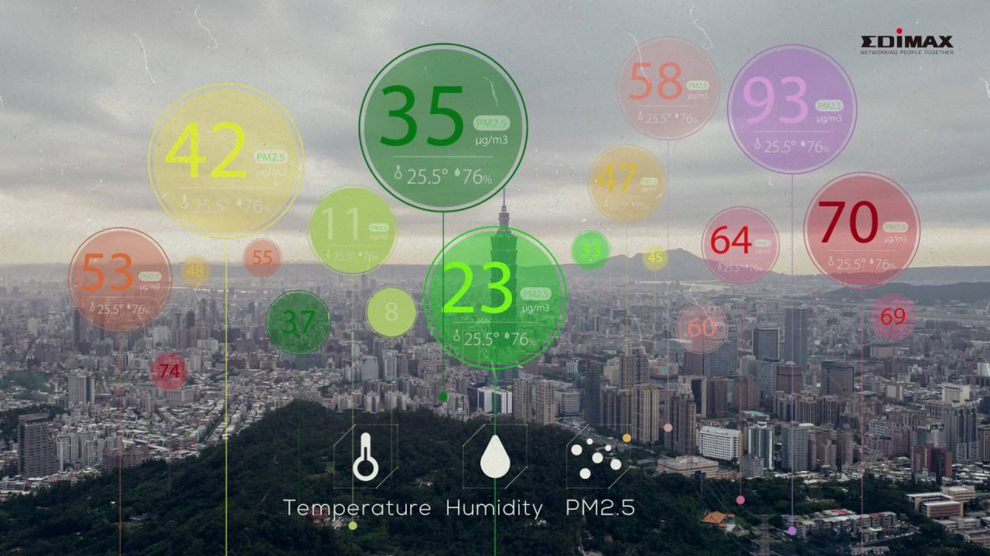
Air quality monitoring System

Slide 14
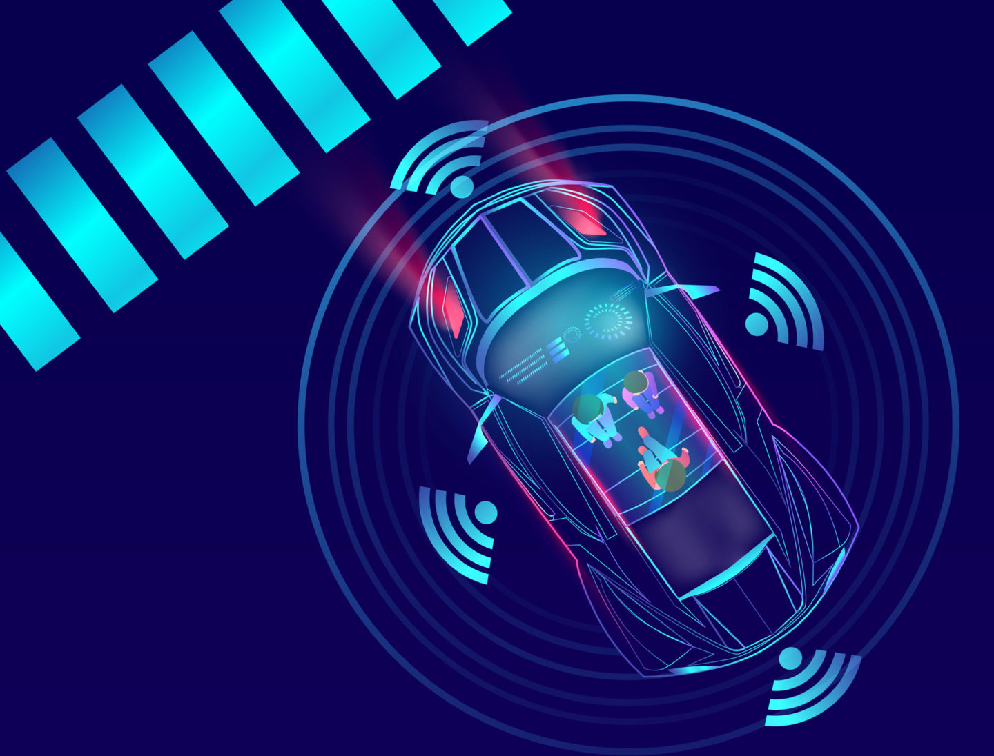
Self driving car

Slide 15
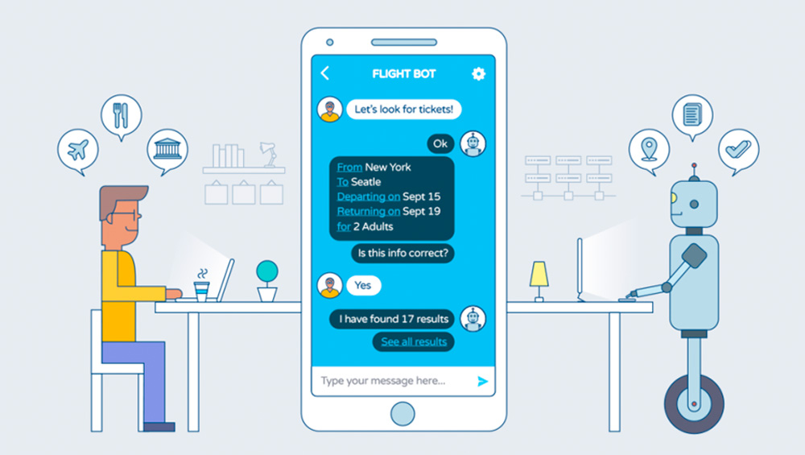
Chat bot

